Slide 1


Roofline Model Toolkit : A Practical Tool for Architectural and Program Analysis
Yu Jung Lo*, Samuel Williams†, Brian Van Straalen†, Terry Ligocki†, Matthew Cordery†, Nicholas Wright†, Mary Hall*, Leonid Oliker†
*University of Utah † Lawrence Berkeley National Laboratory
yujunglo@cs.utah.edu

Slide 2
Motivation
Performance Model
Architecture Characterization
Application Performance Measurement
Issues
Hard to find technical specs for most HPC platforms to form “textbook” Roofline model.
Even with technical specs, the real issue is achievable performance.
Empirical benchmark-driven Roofline model

Slide 3
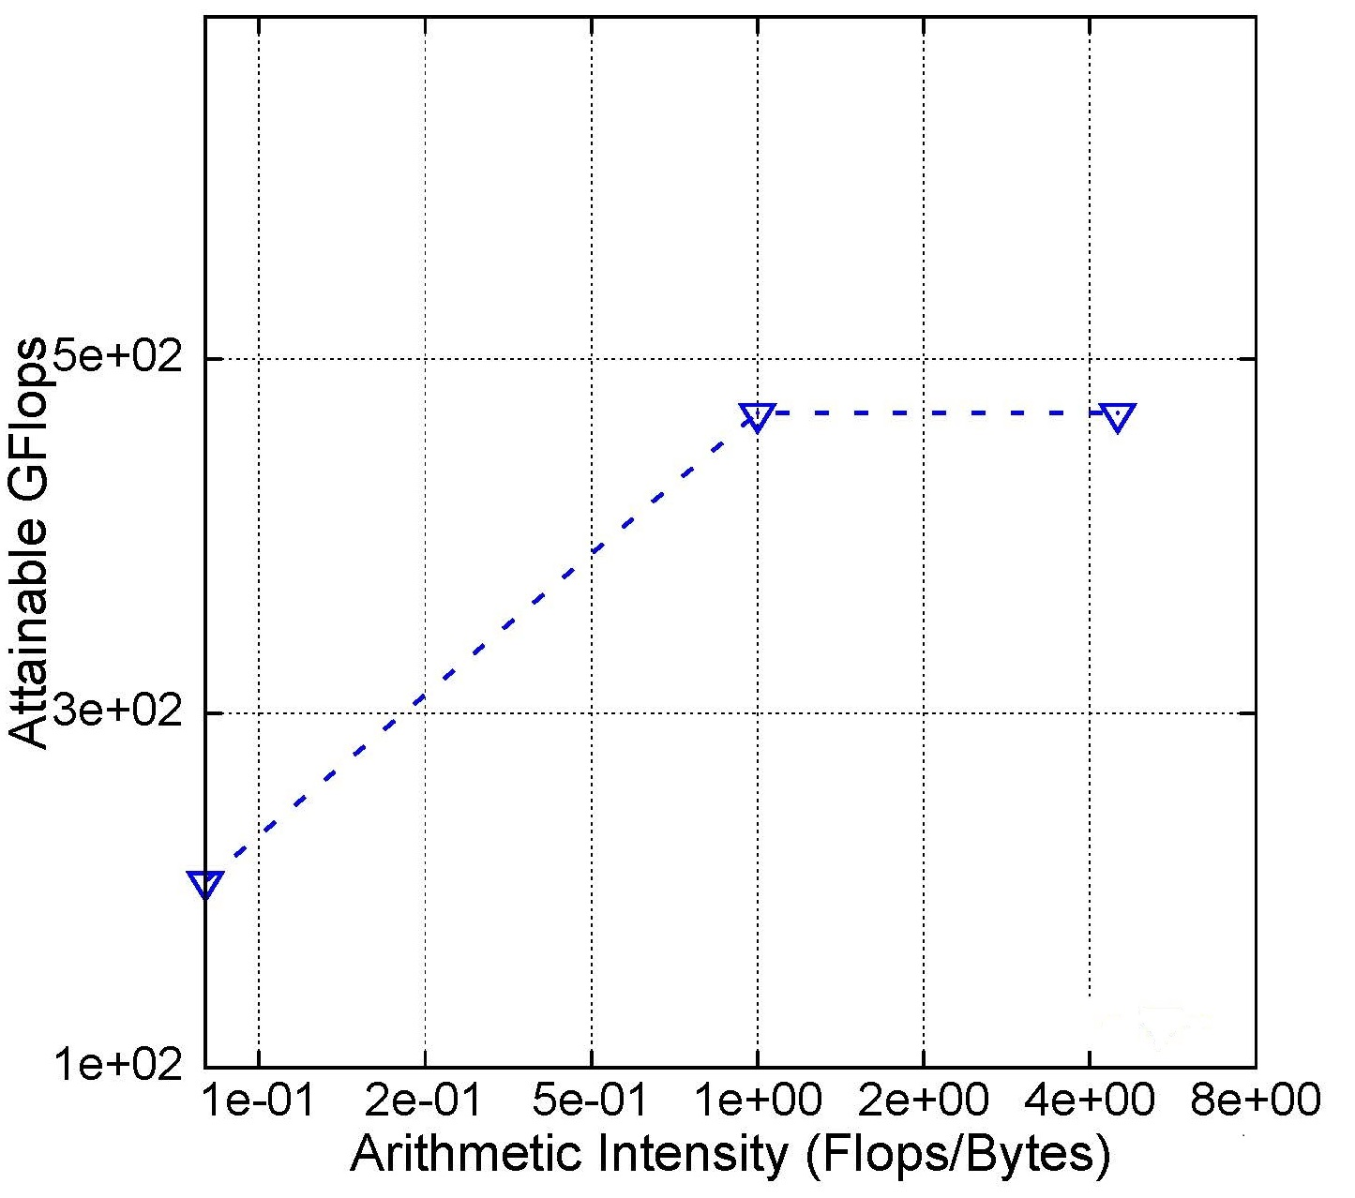
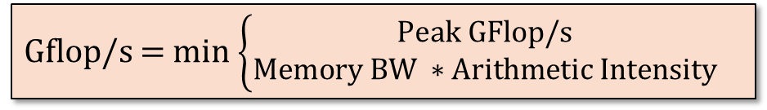
“Theoretical” Roofline Model
Peak FP Performance
Gflop/s = min $\left\{\begin{aligned}Peak GFlop/s \\ Memory BW ∗Arithmetic Intensity\end{aligned}\right.$
Peak Memory Bandwidth

Slide 4
Micro Benchmarks
Driver
int main () { #pragma omp parallel private(id) { uint64_t n, t; initialize(&A[nid]); for (n = 16; n < SIZE; n *= 1.1) { for (t = 1; t < TRIALS; t *= 2) { // start timer here Kernel(n, t, &A[nid]); // stop timer here #pragma omp barrier #pragma omp master { MPI_Barrier(MPI_COMM_WORLD); }
}}}
Bandwidth
void Kernel (uint64_t size, unit64_t trials, double * __restrict__ A) { double alpha = 0.5; uint64_t i, j; for (j = 0; j < trials; ++j ) { for (i = 0; i < nsize; ++i) { A[i] = A[i] + alpha; } alpha = alpha * 0.5; }}
Init
Compute
Sync
double bytes = 2 * sizeof(double) * (double)n * (double)t;

Slide 5
Micro Benchmarks (cont’)
Driver
int main () { #pragma omp parallel private(id) { uint64_t n, t; for (n = 16; n < SIZE; n *= 1.1) { for (t = 1; t < TRIALS; t *= 2) { // start timer here Kernel(n, t, &A[nid]); // stop timer here #pragma omp barrier #pragma omp master { MPI_Barrier(MPI_COMM_WORLD); }
}}}
GFlops
void Kernel (uint64_t size, unit64_t trials, double * __restrict__ A) { double alpha = 0.5; uint64_t i, j; for (j = 0; j < trials; ++j ) { for (i = 0; i < nsize; ++i) { double bete = 0.8; #if FLOPPERITER == 2 beta = beta * A[i] + alpha; #elif FLOPPERITER == 4 … #endif A[i] = beta; } alpha = alpha * 0.5; }}
Compute
double bytes = FLOPPERITER * (double)n * (double)t;

Slide 6
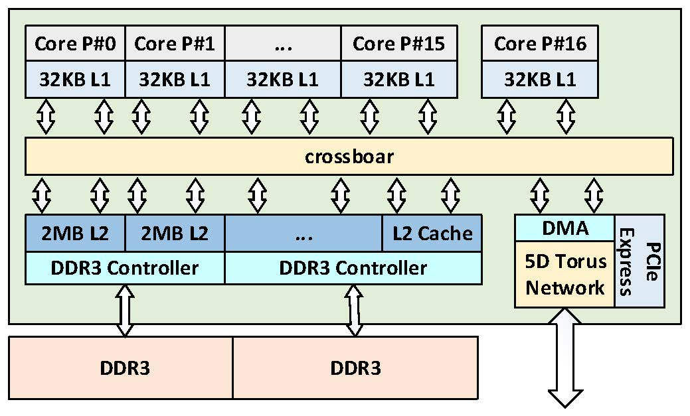
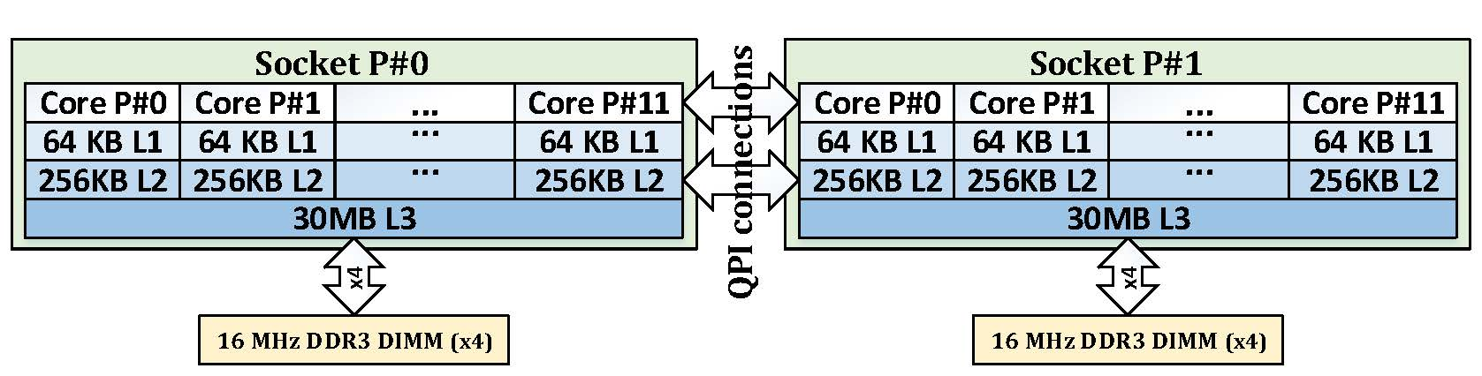
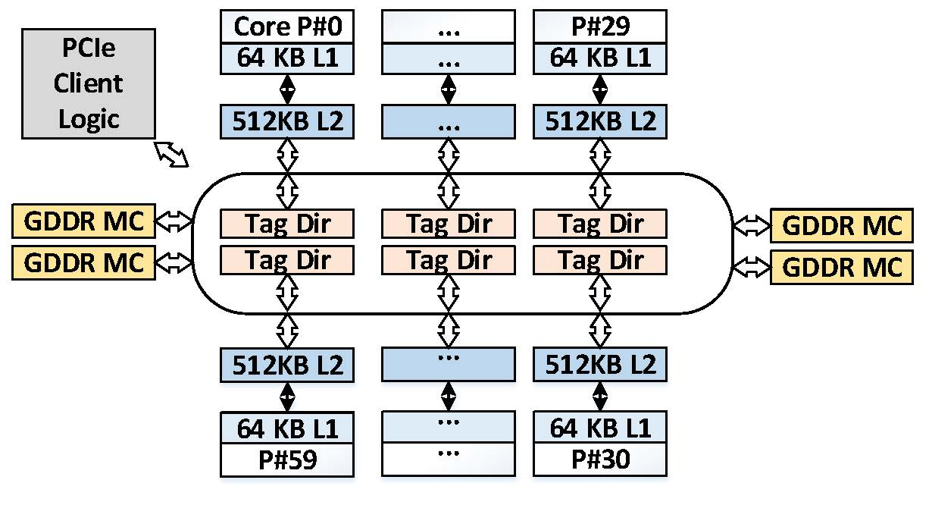
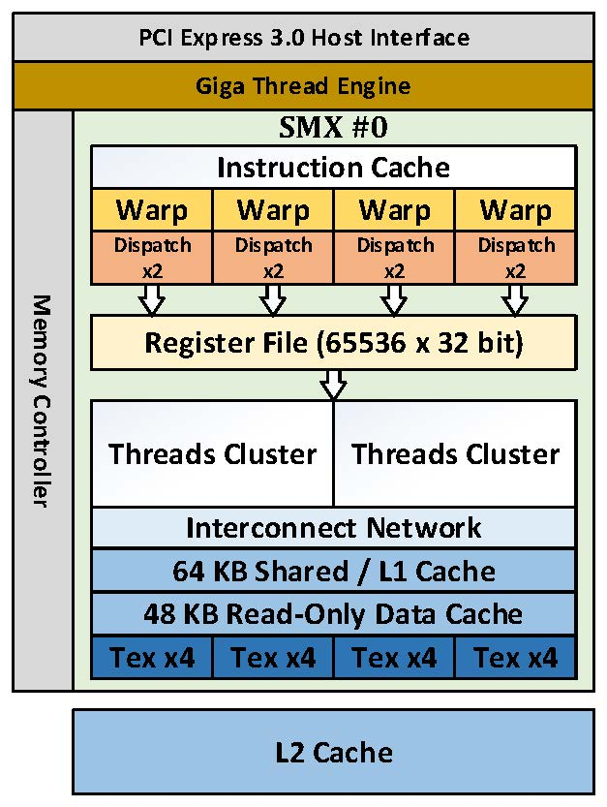
Architectural Platforms
Mira (IBM Blue Gene/Q)
Edison (Intel Xeon CPU)
Babbage (Intel Xeon Phi)
Titan (Nvidia K20x)

Slide 7
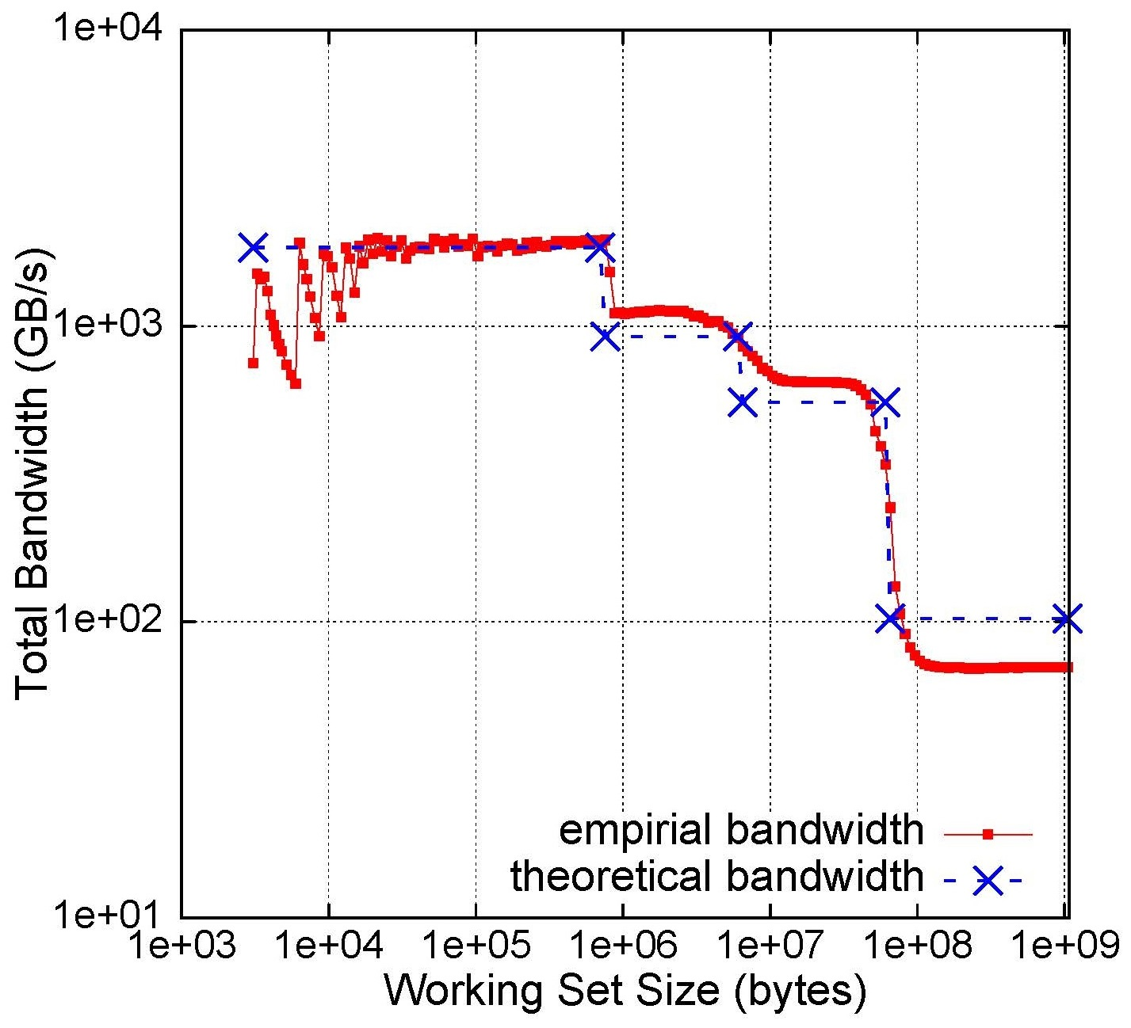
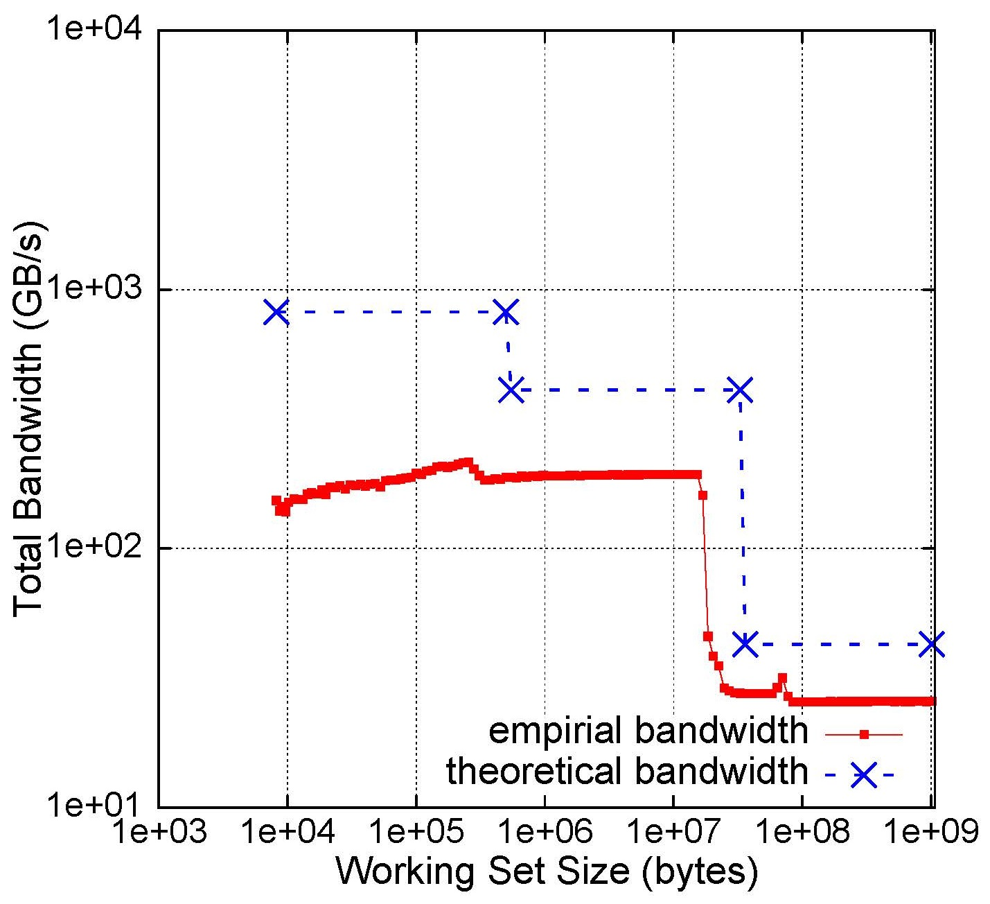
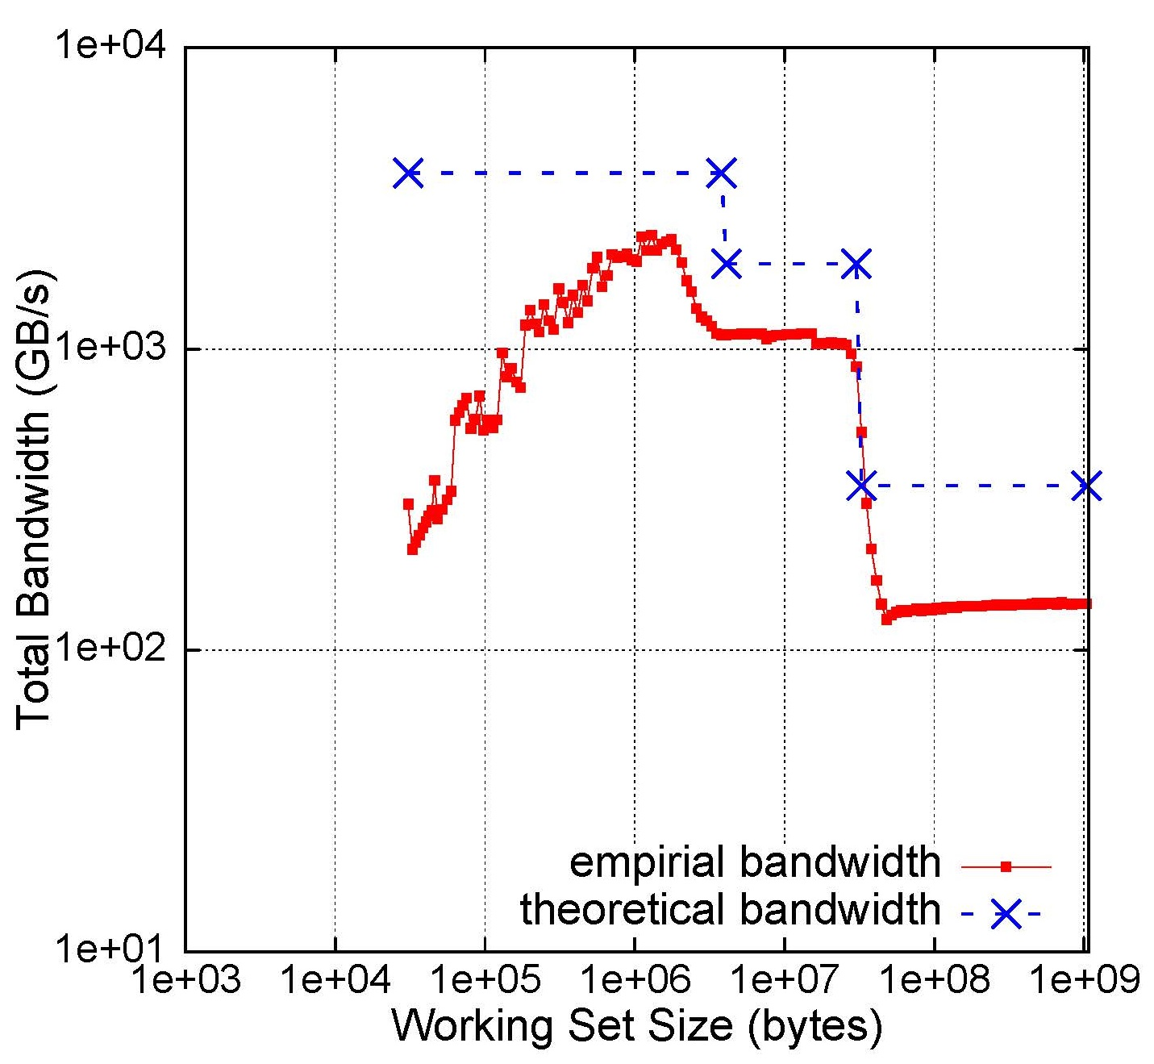
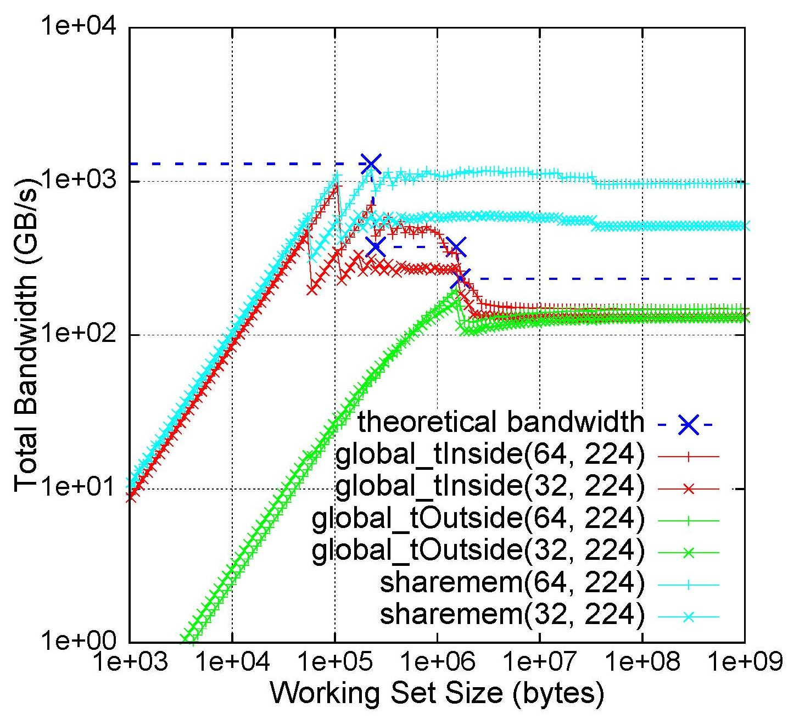
Bandwidth Benchmark Results
Edison (Intel Xeon CPU)
Mira (IBM Blue Gene/Q)
Babbage (Intel Xeon Phi)
Titan (Nvidia K20x)
1 MB

Slide 8
Bandwidth Benchmark Results (cont’)
Titan (Nvidia K20x)
dim3 gpuThreads(64); dim3 gpuBlocks(224); // start timer here
#if defined (GLOBAL_TRIAL_INSIDE)
global_trialInside <<<gpuBlocks, gpuThreads>>> (nsize, trials, d_buf);
#elif defined(GLOBAL_TRIAL_OUTSIDE)
for (uint64_t t = 0; t < trials; ++t) {
global_trialOutside <<<gpuBlocks, gpuThreads>>> (nsize, d_buf, alpha); alpha = alpha * (1 – 1e-8); }
#else
sharedmem <<<gpuBlocks, gpuThreads>>> (nsize, trials, d_buf);
#endif
cudaDeviceSynchronize();
// stop timer here
A
B
C
(blocks, threads)

Slide 9
Optimized GFlops Benchmarks
C Code
AVX Code (Edison)
double alpha = 0.5; for (j = 0; j < ntrials; ++j ) { for (i = 0; i < nsize; ++i) { double bete = 0.8; beta = beta * A[i] + alpha; A[i] = beta; } alpha = alpha * (1e-8); }
for (j = 0 ; j < ntrials; ++j) { for (i = 0 ; i < nsize ; i += 8) { bv1 = _mm256_set1_pd(0.8); v1 = _mm256_load_pd(&A[i]); bv1 = _mm256_mul_pd(bv1, v1); bv1 = _mm256_add_pd(bv1, v1); _mm256_store_pd(&A[i], bv1); // repeat above operations for A[i+4] } alpha = alpha * (1e-8); av = _mm256_set1_pd(alpha); }
Unroll by 8
2 Flops per Element
QPX Code (Mira)
AVX-512 Code (Babbage)
for (j = 0 ; j < ntrials ; ++j){ for (i = 0 ; i < nsize ; i += 8){ bv1 = vec_splats(0.8); v1 = vec_ld(0L, &A[i]); bv1 = vec_madd(bv1,v1,av); vec_st(bv1, 0L, &A[i]); // repeat above operations for A[i+4] } alpha = alpha * (1e-8); vec_splats(alpha); }
for (j = 0 ; j < ntrials ; ++j) { for (i = 0 ; i < nsize ; i += 8) { bv1 = _mm512_set1_pd(0.8); v1 = _mm512_load_pd(&A[i]); bv1 = _mm512_fmadd_pd(bv1,v1,av); _mm512_store_pd(&A[i], bv1); } alpha = alpha * (1e-8); av = _mm512_set1_pd(alpha); }
Fused Multiply & Add
Fused Multiply & Add

Slide 10
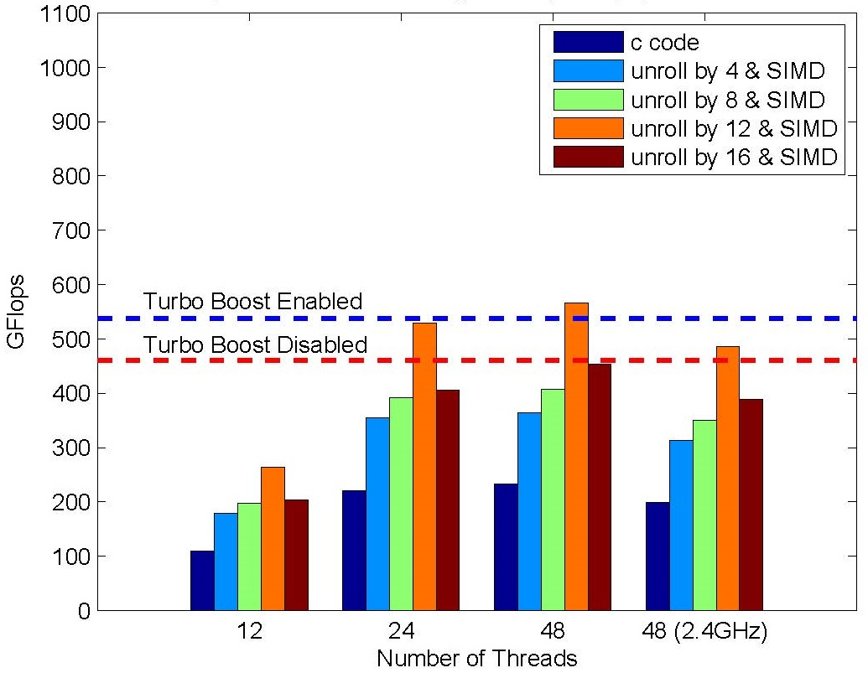
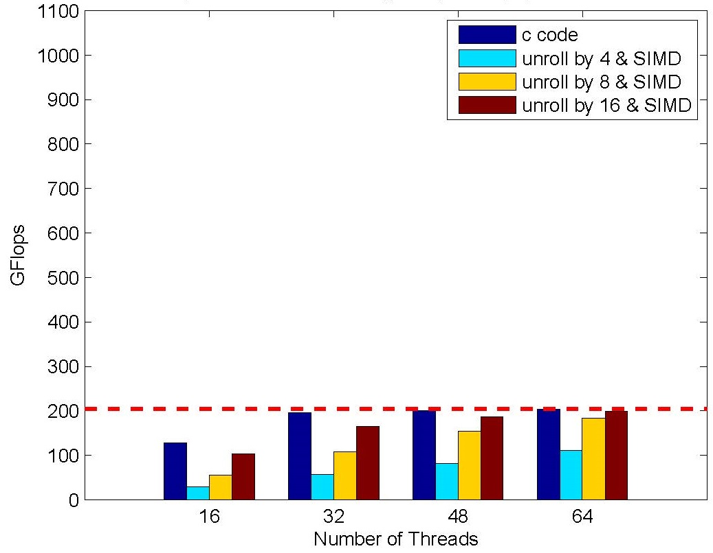
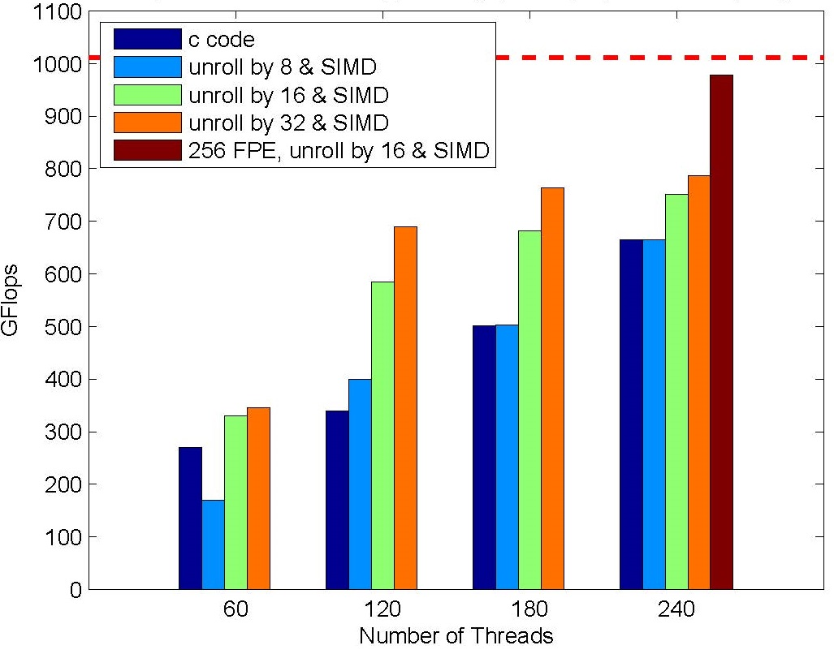
Gflops Performance
Edison (Intel Xeon CPU), 8 FPE
Mira (IBM Blue Gene/Q), 16 FPE
Turbo Boost
Theoretical Peak
C code
Babbage (Intel Xeon Phi), 16 FPE
Optimized code
256 FPE, SIMD and unrolled by 16

Slide 11
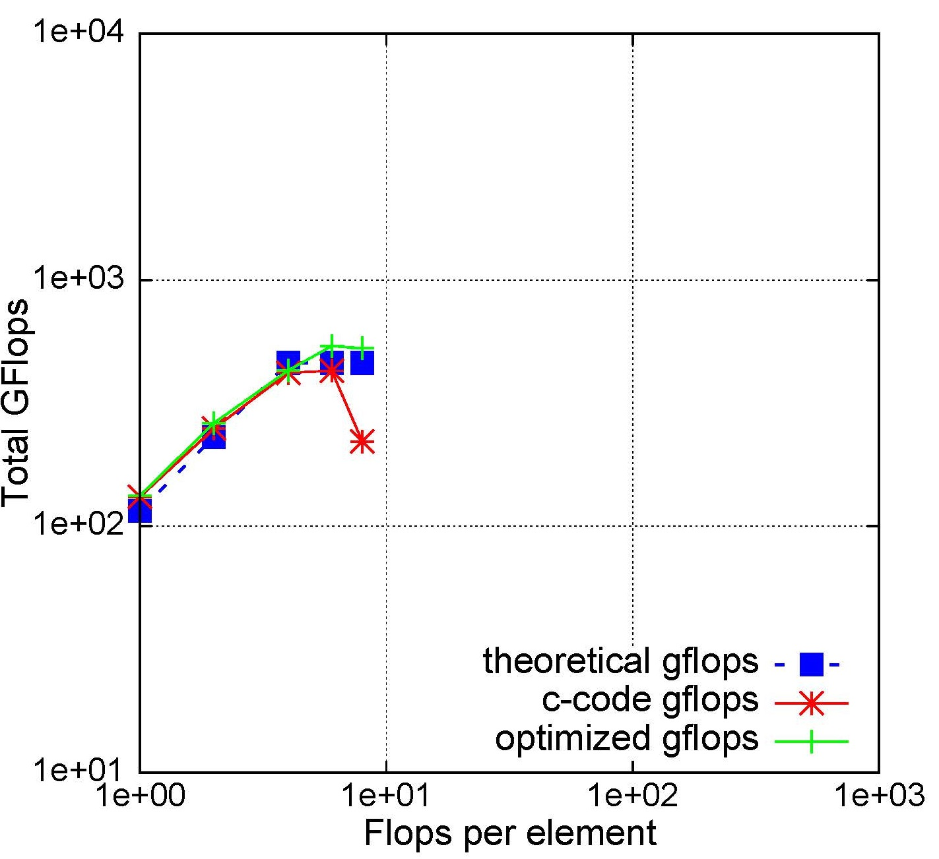
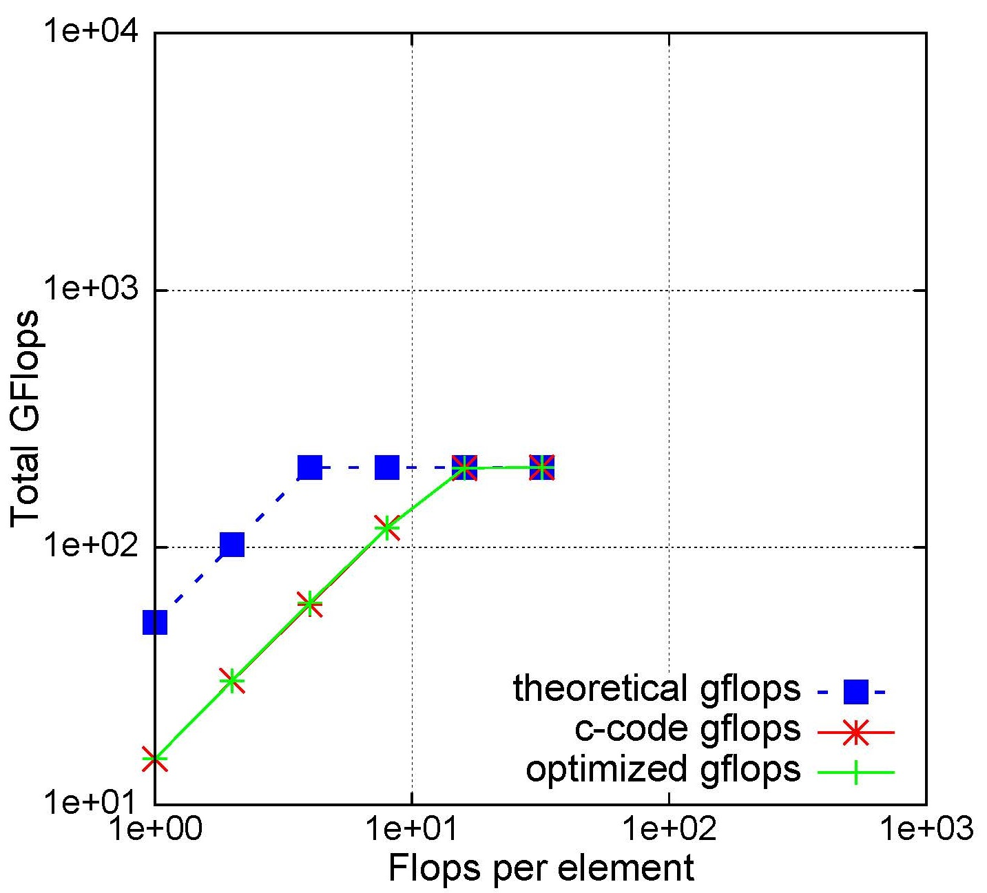
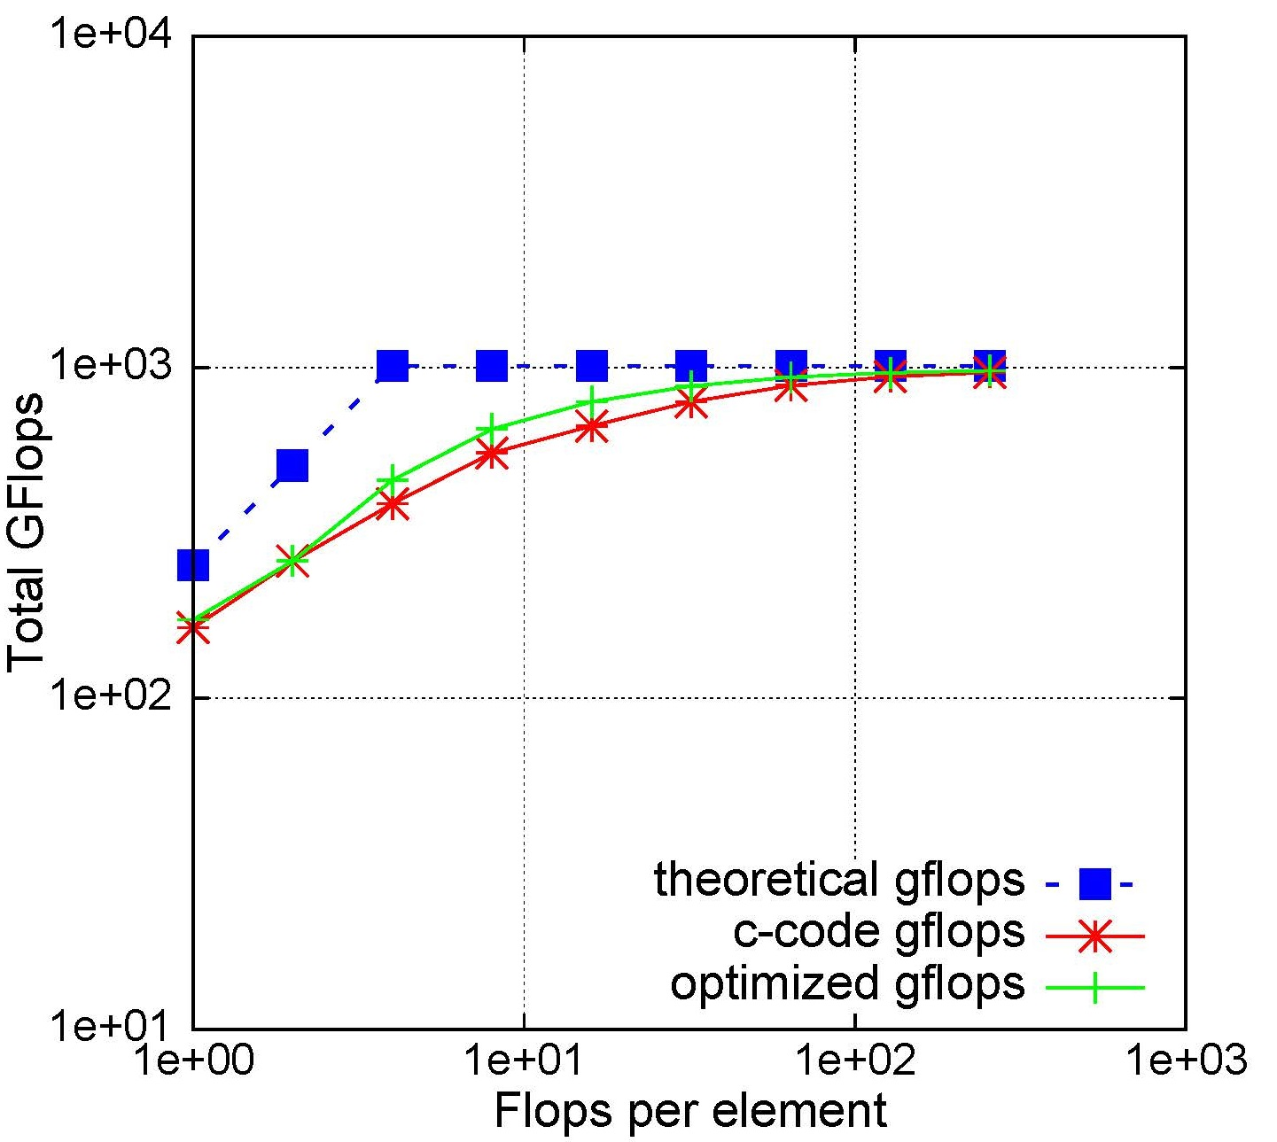
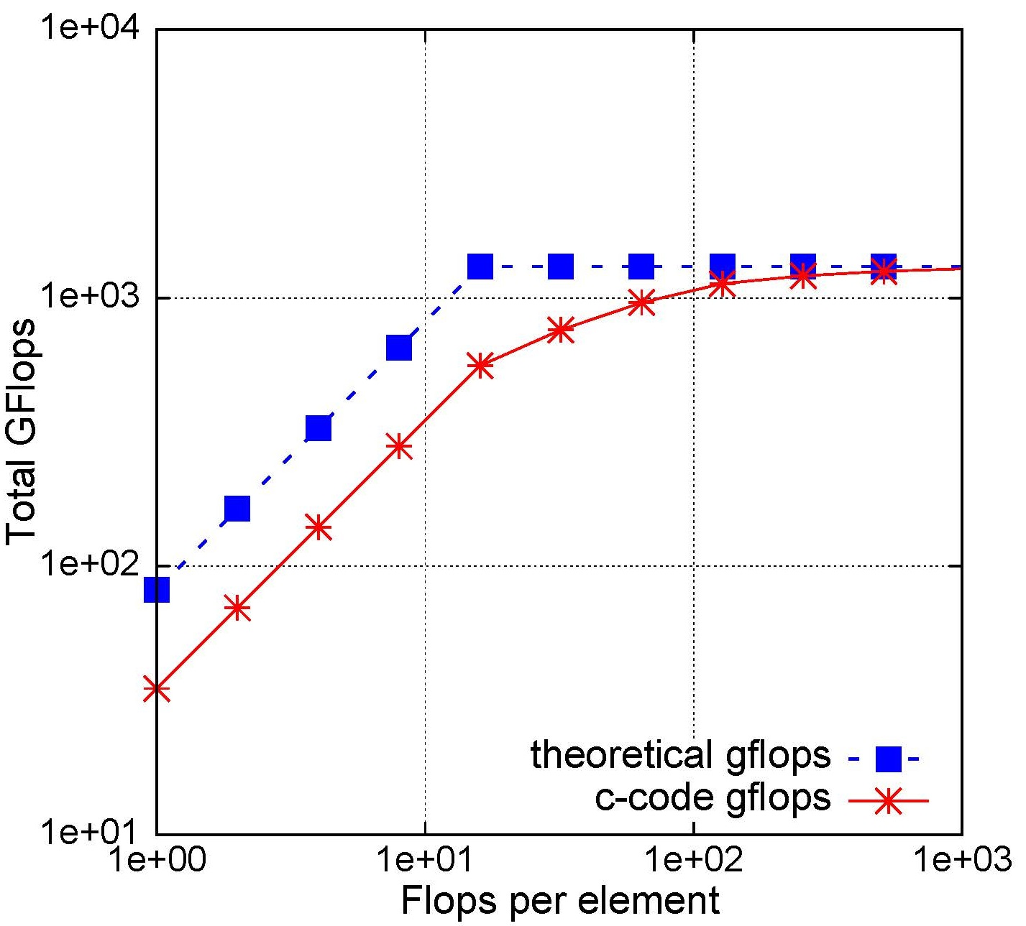
Gflops Performance (cont’)
Edison (Intel Xeon CPU)
Mira (IBM Blue Gene/Q)
Babbage (Intel Xeon Phi)
Titan (Nvidia K20x)

Slide 12
Beyond the Roofline

Slide 13
CUDA Unified Memory
CUDA’s Memory Concept
Four Approaches to Manage Memory
Explicit Copy
Separate Address Spaces
2
1
Page-locked Host
with Explicit Copy
Pageable Host
with Explicit Copy
Unified Virtual Addressing (UVA)
Page-locked Host
with Zero Copy
3
4
Unified Memory
with Zero Copy
Unified Memory
Implicit Copy

Slide 14
CUDA Managed Memory Benchmark
int main() { // start timer here… for (uint64_t j = 0; j < trials; ++j) {
for (uint64_t k = 0; k < reuse; ++k) { GPUKERNEL <<<blocks, threads>>> (n, d_buf, alpha); alpha = alpha * (1e-8); }
CPUKERNEL(n, h_buf, alpha); } // stop timer here… double bytes = 2 * sizeof(double) * (double)n * (double)trials * (double)(reuse + 1); }
#if defined(_CUDA_ZEROCPY) || defined(_CUDA_UM) cudaDeviceSynchronize();
#else cudaMemcpy(d_buf, h_buf, SIZE, cudaMemcpyDefault); #endif
K iterations
3
4
#if defined(_CUDA_ZEROCPY) || defined(_CUDA_UM) cudaDeviceSynchronize();
#else cudaMemcpy(h_buf, d_buf, SIZE, cudaMemcpyDefault); #endif
1
2
K + 1 iterations

Slide 15
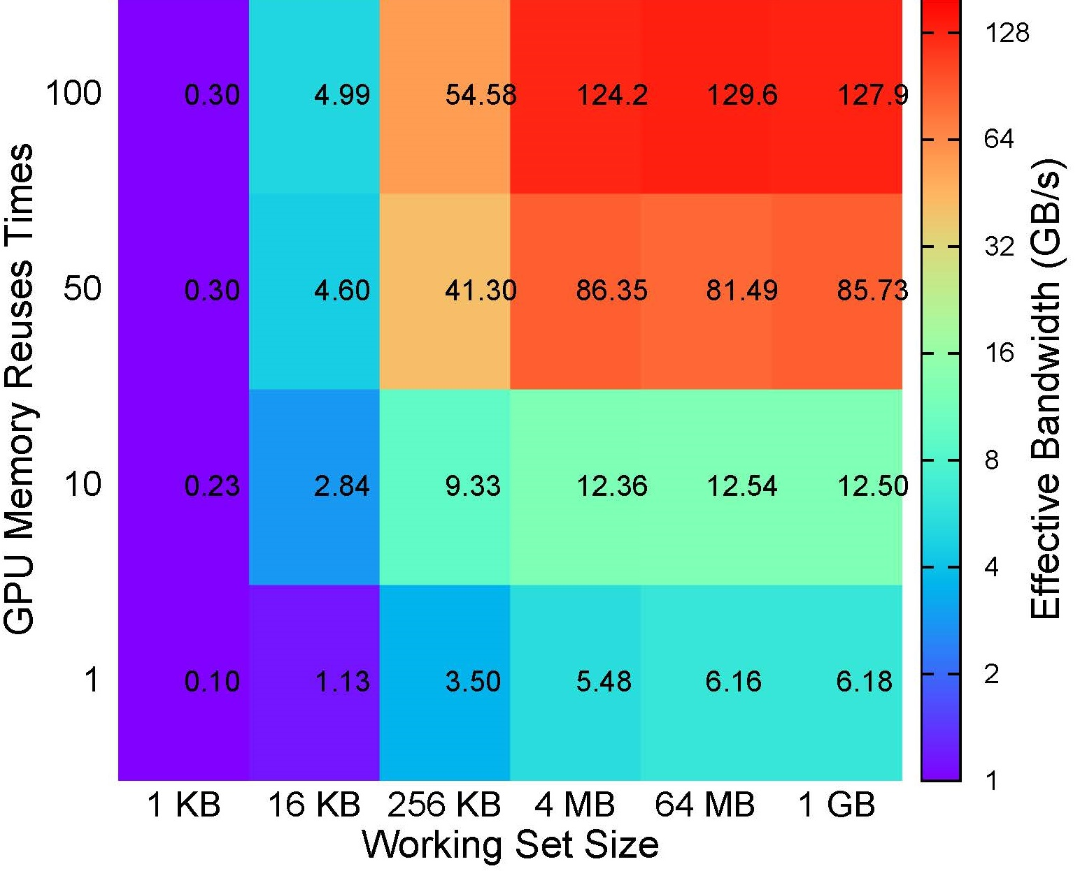
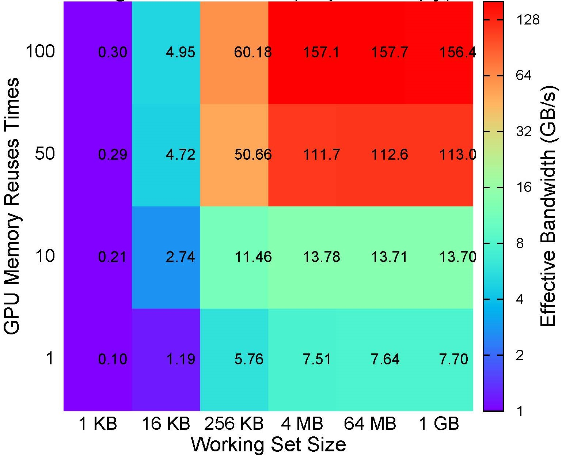
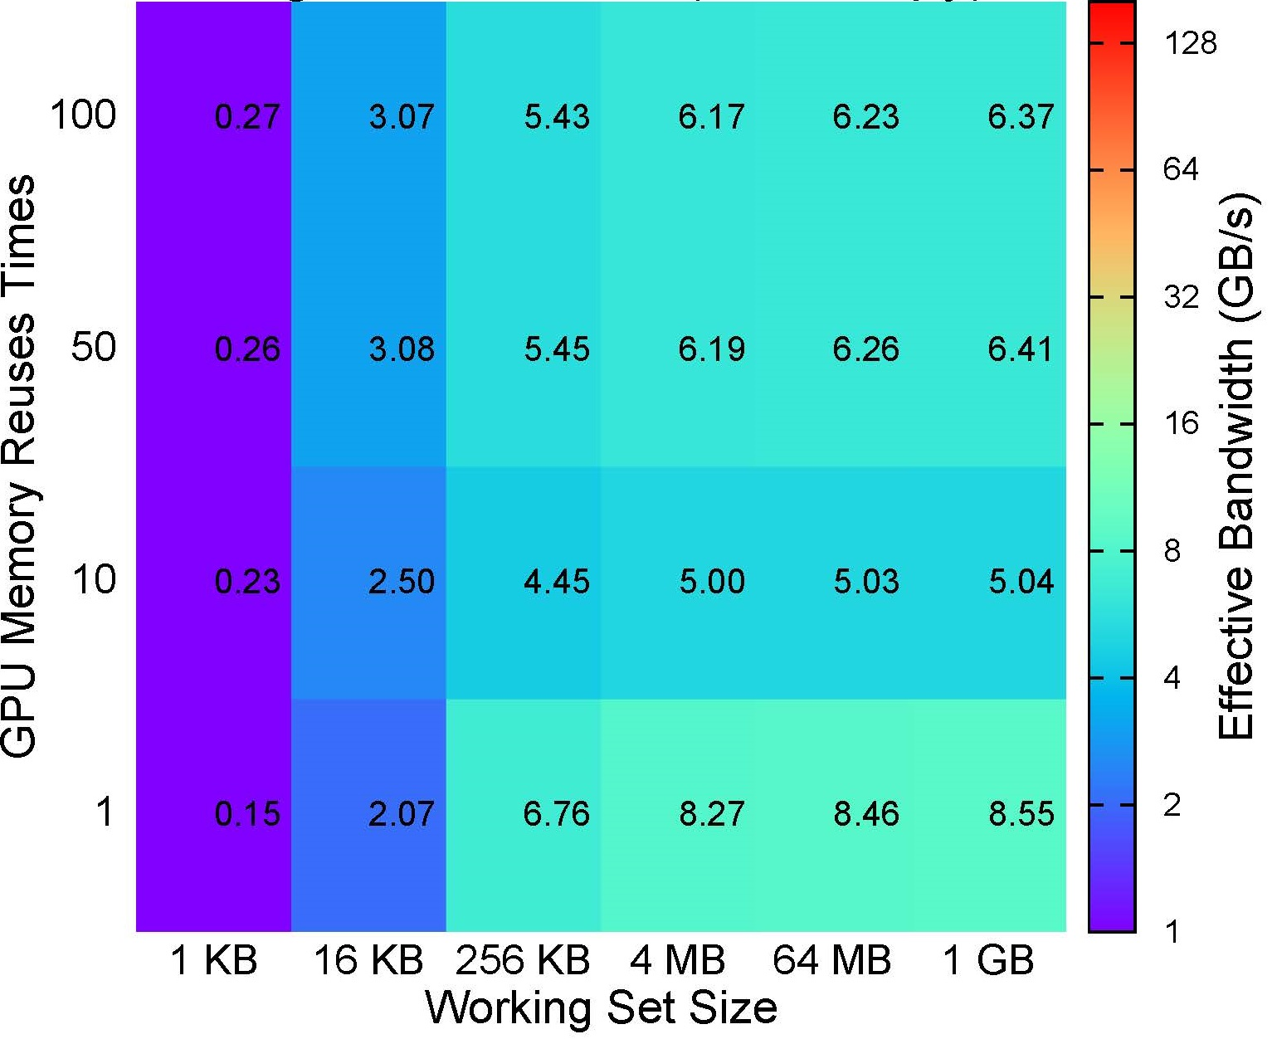
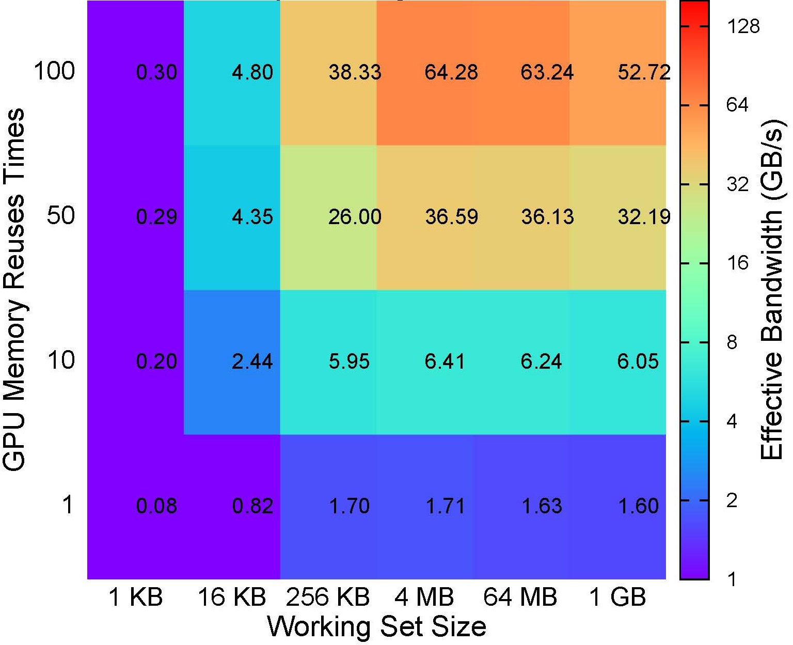
CUDA Managed Memory Performance
1
Pageable host w/ explicit copy
2
Page-locked host w/ explicit copy
128 GB/s
156 GB/s
3
Page-locked host w/ zero copy
4
Unified Memory w/ zero copy
* GPU driver version: 331.89; toolkit version: 6.0beta

Slide 16
Construct the Roofline Model

Slide 17
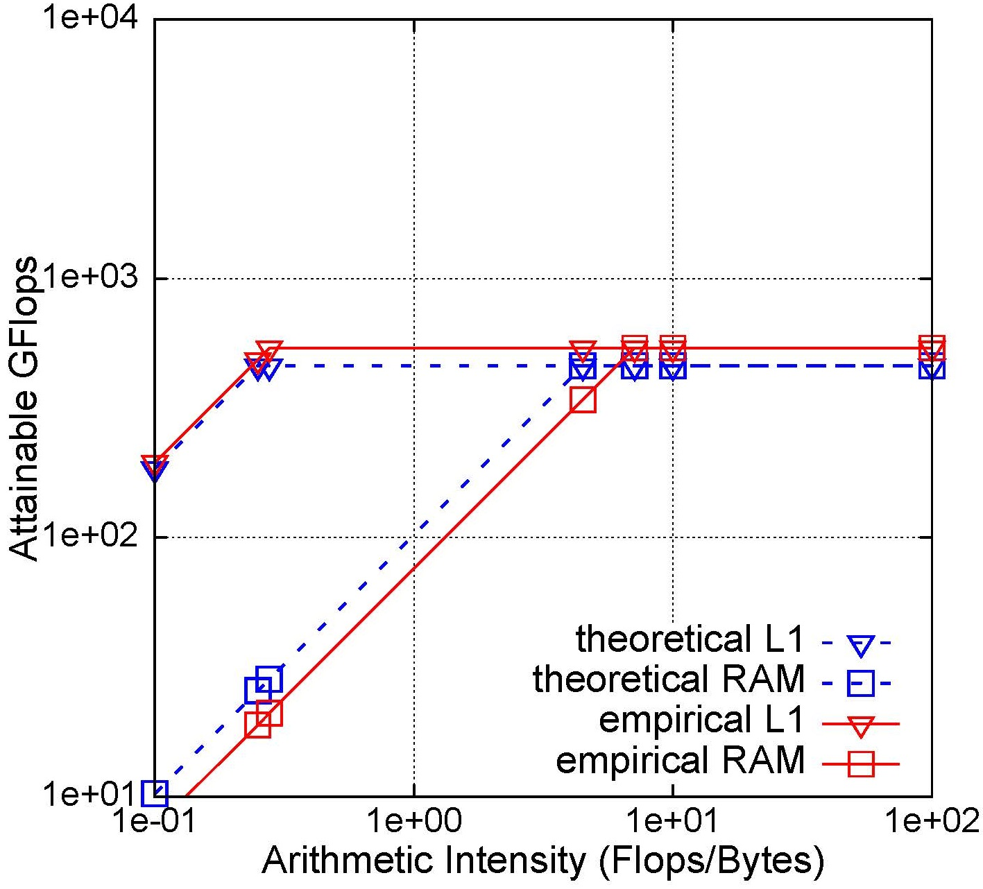
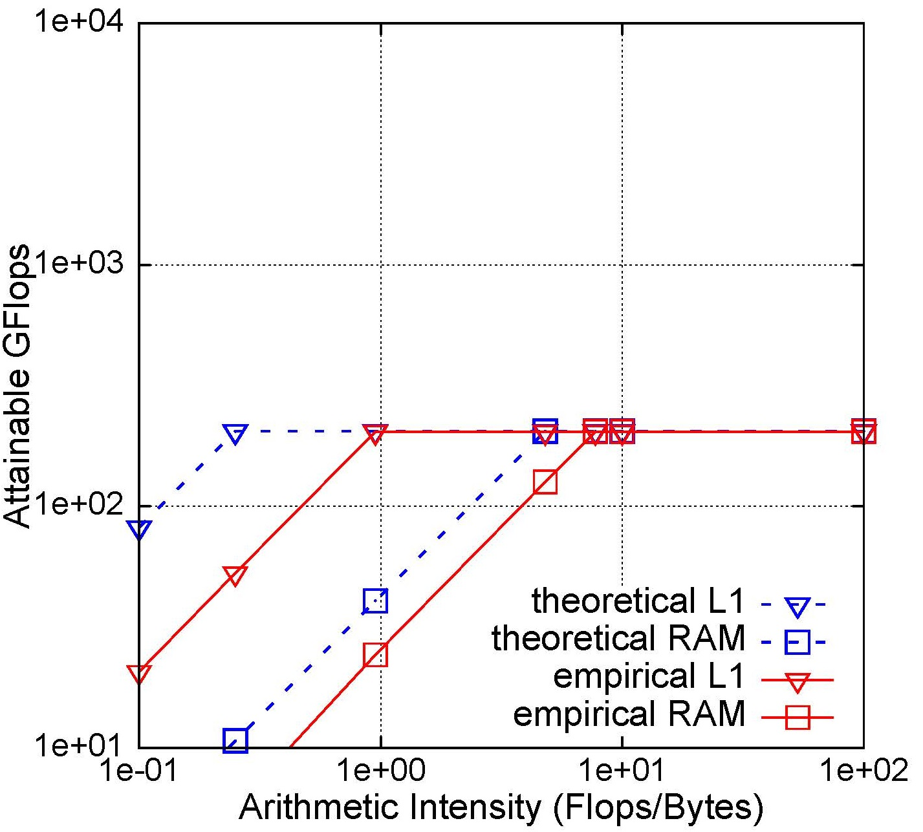
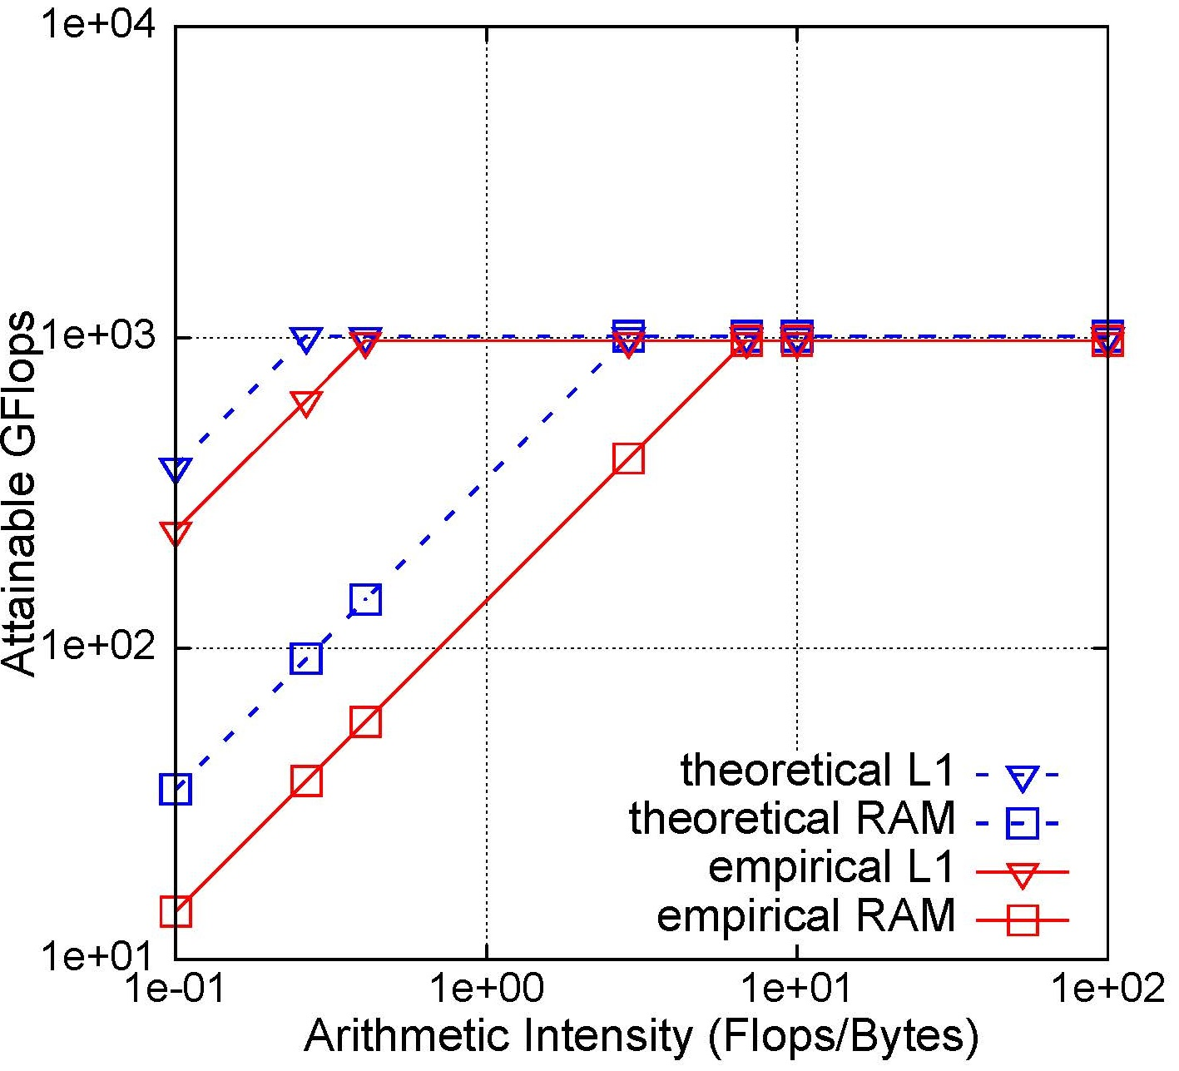
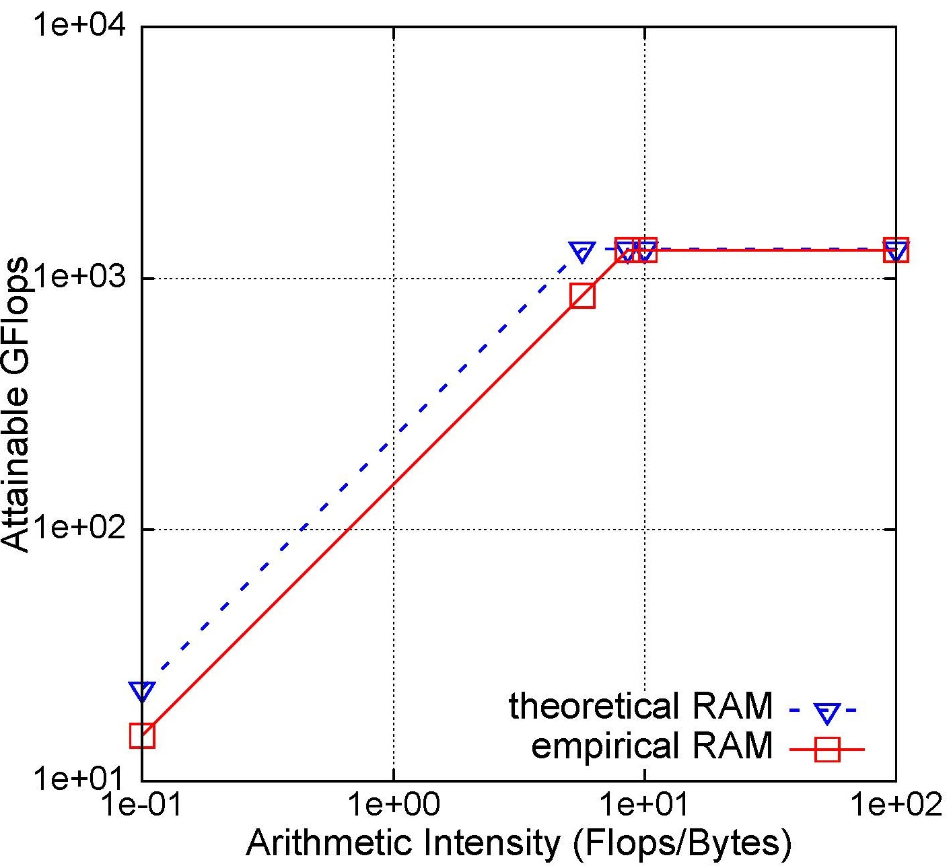
Empirical Roofline Model
Edison (Intel Xeon CPU)
Mira (IBM Blue Gene/Q)
Babbage (Intel Xeon Phi)
Titan (Nvidia K20x)

Slide 18
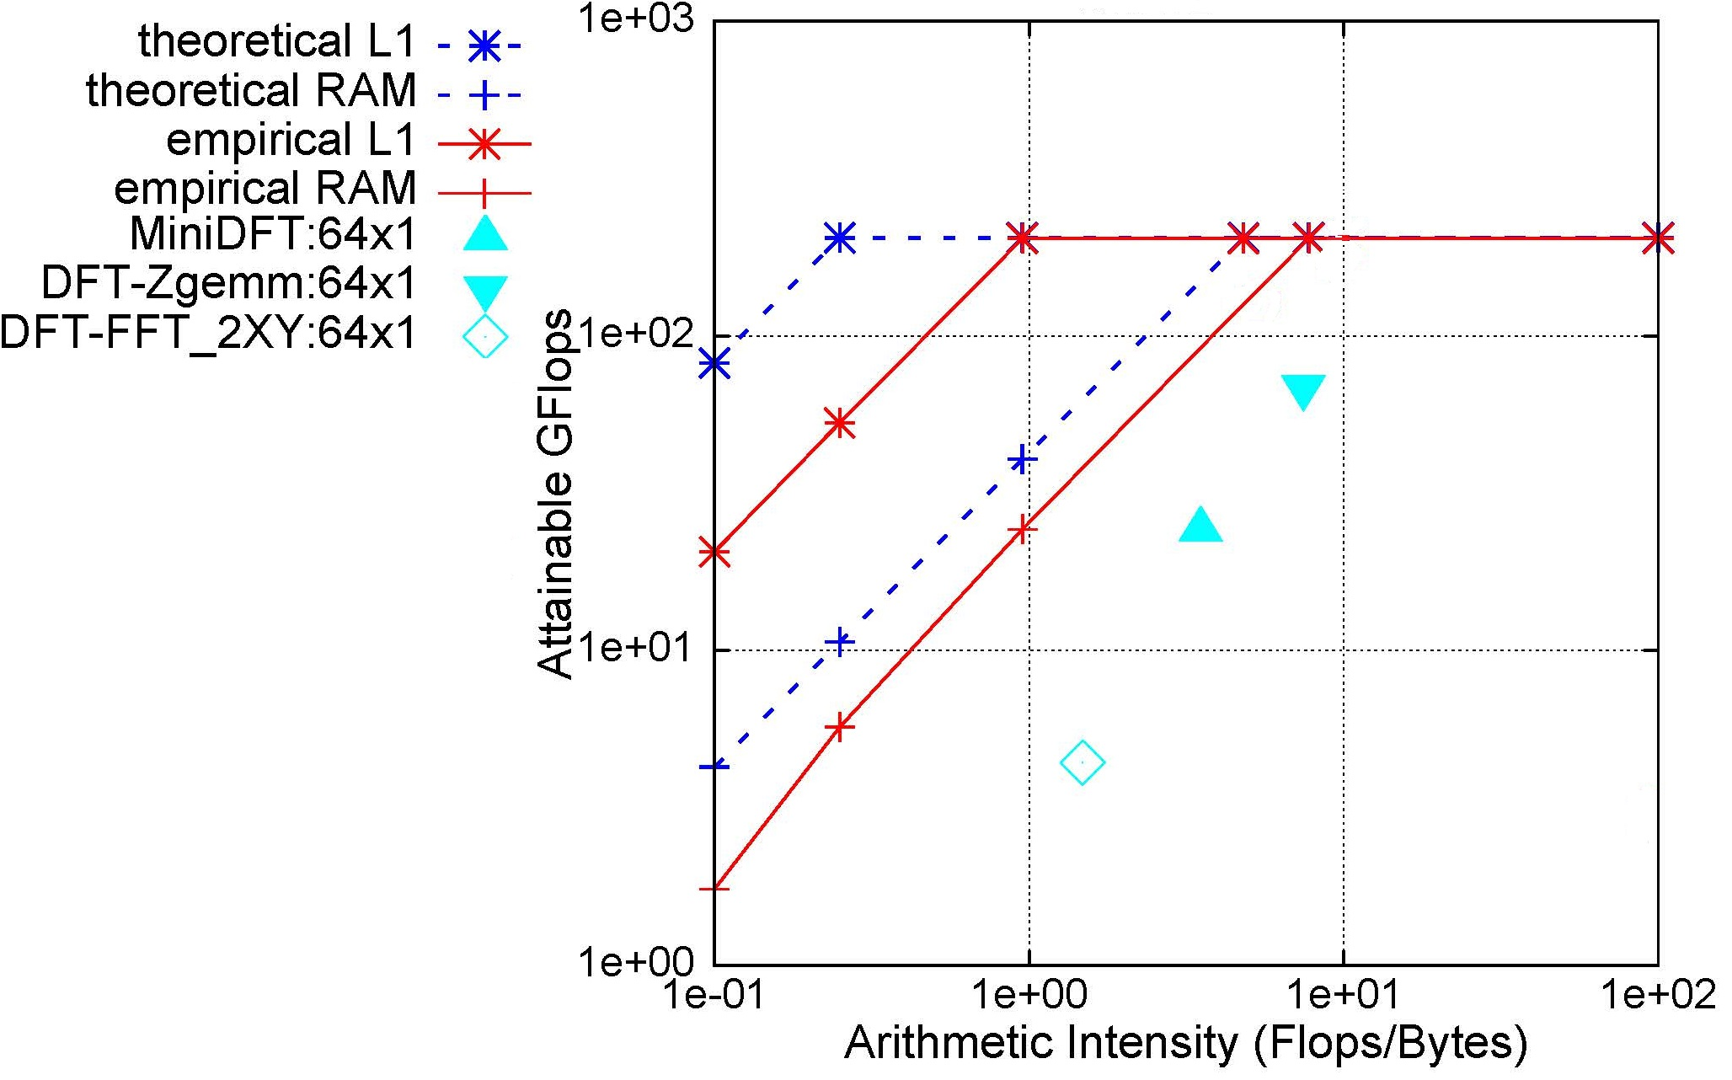
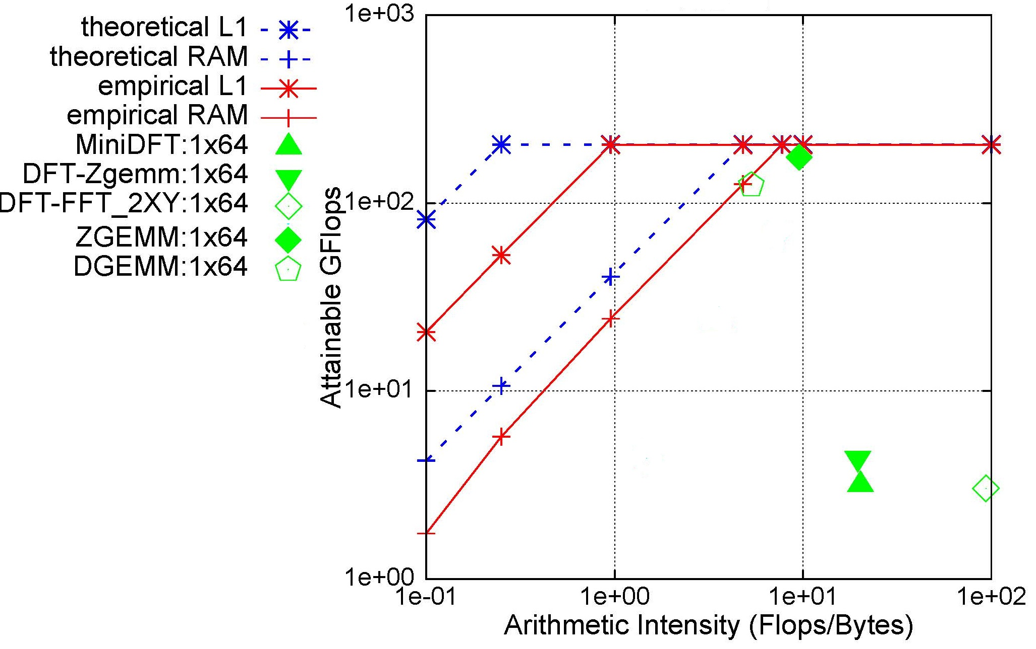
Application Analysis : MiniDFT
Flat MPI
MPI tasks x OpenMP threads

Slide 19
Conclusion
Way to get high bandwidth on manycore and accelerated architectures.
Massive parallelism on large working sets.
Way to get high Gflops
Sufficient SIMDized and unrolled.
At least 2 threads per core for in-order processor.
High FPE for manycore and accelerators.
Way to get high CUDA managed memory performance
Highly reuse the data on device, operate on large working set, and explicit copy between host and device.

Slide 20
Questions?

Slide 21
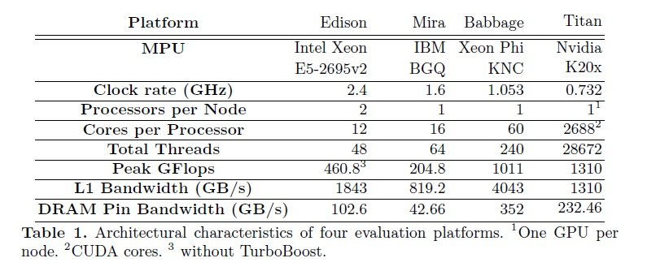
Appendix

Slide 22
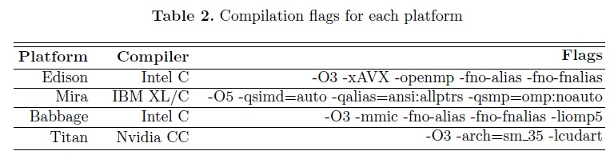
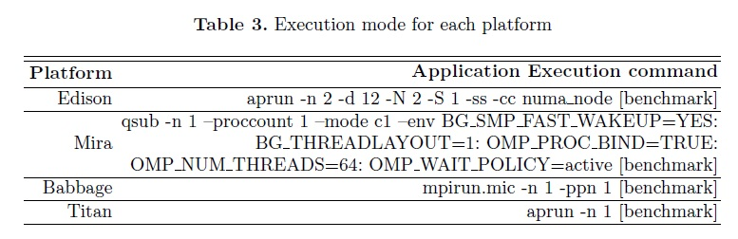
Appendix

